Slide 1
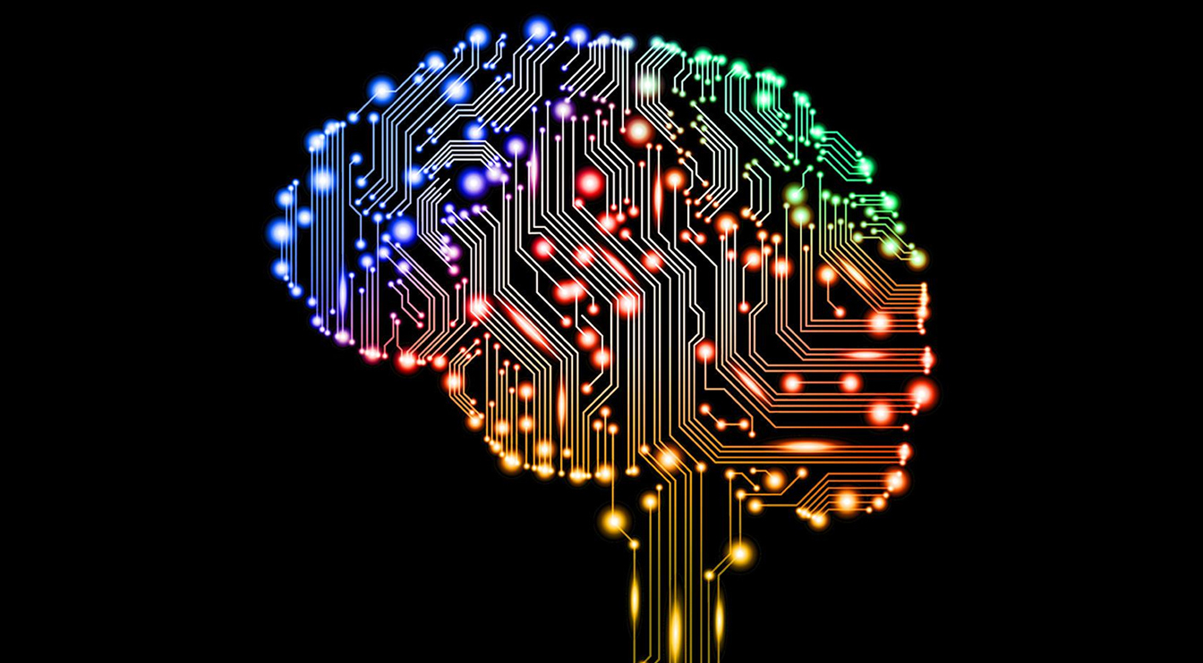

AI and the Future
Windsor SIRS
November 20, 2023

Slide 2

What is AI?
AI stands for "Artificial Intelligence." It is a branch of computer science that deals with the development of intelligent machines that can perform tasks that would typically require human intelligence. AI aims to create computer systems capable of learning, reasoning, and problem-solving.
AI can be categorized into two types: Narrow AI and Generative AI. Narrow AI, also known as Weak AI, refers to AI systems that are designed to perform specific tasks, such as voice recognition, image classification, or playing chess. These systems are specialized in a particular area and lack the ability to generalize beyond their specific domain.
On the other hand, Generative AI, also known as Strong AI or AGI (Artificial General Intelligence), refers to AI systems that possess the ability to understand, learn, and apply knowledge across various domains, similar to human intelligence. General AI can perform any intellectual task that a human can do, making it capable of reasoning, understanding natural language, and adapting to new situations.
AI utilizes several techniques and methodologies to achieve its objectives. Some common approaches include machine learning, which involves training algorithms on large datasets to learn patterns and make predictions, and deep learning, a subset of machine learning that uses artificial neural networks to mimic the structure and function of the human brain.
Notes:
We are just beginning to use AI. It isn’t always accurate. They have "hallucinations”. Large language models Deep Mind announced it has successfully used artificial intelligence to predict the 3D structures of nearly every catalogued protein known to science. That's over 200 million proteins

Slide 3
What Can it be Used For?
AI can provide various benefits and services to end users. Here are some ways AI can enhance the user experience:
Personalized Recommendations: AI algorithms can analyze user preferences, behavior, and historical data to provide personalized recommendations for products, services, movies, music, and more. This helps users discover new things tailored to their individual tastes.
Virtual Assistants: AI-powered virtual assistants, such as Siri, Alexa, CoPilot and Google Assistant, can help users with tasks like setting reminders, making reservations, searching the web, and controlling smart home devices. These assistants use natural language processing and machine learning to understand and respond to user commands.
Customer Service: AI chatbots and virtual agents are increasingly being used to provide customer support and handle inquiries. They can provide instant responses to common questions, offer troubleshooting assistance, and escalate complex issues to human agents when necessary.

Slide 4
What Can it be Used For?
Smart Home Automation: AI can enable users to control various aspects of their homes through voice commands or smartphone apps. AI-powered systems can adjust temperature settings, turn lights on or off, manage security systems, and even learn user preferences to automate daily routines.
Healthcare Support: AI can assist users in monitoring their health, providing insights, and offering personalized recommendations. For example, wearable devices with AI capabilities can track physical activity, sleep patterns, and heart rate to provide users with feedback and suggestions for improving their well-being. Additionally, it can be used to speed the development of new drugs.
Content Creation: AI can help users generate content, such as automated transcription services, language translation, creative writing assistance and even pictures, video and music. These tools can save time and provide valuable support to users.

Slide 5
What Can it be Used For?
Image and Video Recognition: AI algorithms can analyze and categorize visual content. This technology is used in applications like facial recognition for unlocking devices, automatic photo tagging, content moderation, and object recognition in augmented reality (AR) experiences.
Financial Services: AI can be utilized in various financial applications, such as fraud detection, credit scoring, and personalized financial planning. AI-powered chatbots can also provide users with real-time financial information and assistance in managing their finances.
Education and Learning: AI-based learning platforms can personalize educational content and adapt to individual student needs. AI tutors can provide personalized feedback, suggest additional resources, and adapt the learning pace to optimize the educational experience.
Travel Assistance: AI-powered travel platforms can help users plan trips, find the best deals, suggest itineraries, and provide real-time updates on flight statuses and weather conditions. AI can also assist with language translation and navigation in unfamiliar locations.

Slide 6
What Can it be Used For?
AI can now do a better job of reading X-rays and MRI scans than doctors. Recent tests have shown that in diagnosis AI scored 90 while doctors scored 75.
Drug companies will be able to create new drugs faster and cheaper than previously. They will also be able to do early testing on a computer before they move to living subjects.
Businesses will be able to automate routine or repetitive work freeing employees for more significant tasks. There is a great deal of concern about whether this will destroy jobs or create jobs and who will be affected. It will also be used for programming, including writing code and debugging.
Self driving vehicles are powered by AI algorithms. Ultimately this will lead to fewer accidents with reductions in injury, loss of life and property damage. This should also lead to lower insurance costs.
These are just a few examples of how AI can benefit people. AI's ability to process vast amounts of data, make predictions, and learn from user interactions enables it to provide personalized and valuable services to individuals.

Slide 7
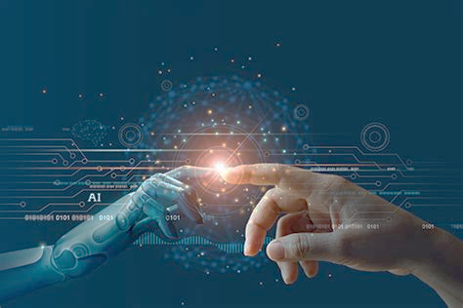
What are Some Concerns with AI
Bias and Fairness: AI systems can inherit biases from the data they are trained on, which can lead to unfair and discriminatory outcomes. This bias can be especially problematic in areas like hiring, lending, and criminal justice.
Privacy Concerns: AI systems often require large amounts of data to function effectively. Collecting and handling personal data can raise concerns about privacy and data security, especially when it is used without the informed consent of individuals.
Job Displacement: Automation driven by AI and robotics has the potential to replace certain jobs, particularly those that involve repetitive tasks. This can lead to job displacement and economic disruptions in some industries.
Ethical Concerns: As AI becomes more sophisticated, ethical questions arise regarding its use in sensitive areas such as healthcare, autonomous weapons, and surveillance. Decisions made by AI systems can have profound ethical implications.

Slide 8
AI Concerns
Security Risks: AI can be vulnerable to attacks and manipulation. Adversarial attacks can deceive AI systems, and the use of AI in cyberattacks can make threats more sophisticated and harder to defend against.
Lack of Accountability: When AI systems make mistakes or cause harm, it can be challenging to determine who is responsible. This lack of accountability raises legal and ethical questions.
Loss of Control: As AI systems become more autonomous, there is a risk of losing control over them. This is a concern in applications like self-driving cars and military drones.
Data Dependency: AI systems rely on high-quality and diverse data for training and decision-making. If the data is incomplete, biased, or outdated, it can lead to inaccurate and unreliable results.
Transparency and Explainability: Many AI algorithms, such as deep neural networks, are often seen as "black boxes" because it can be challenging to understand how they arrive at their decisions. Lack of transparency can hinder trust and accountability.
Social Manipulation: AI can be used to create deepfake content, generate misinformation, and manipulate public opinion on a massive scale, posing risks to political and social stability.

Slide 9


AI Concerns
Regulatory Challenges: Policymakers and regulators face challenges in keeping up with the rapid pace of AI development. Establishing effective regulations that balance innovation and safety is a complex task.
Economic Inequality: The benefits of AI are not evenly distributed, and there is a risk of exacerbating economic inequality if access to AI technology and its benefits is not equitable.
Wrong answers known as Hallucinations.
Deep Fakes. Pictures, video and sound which aren’t real
This Photo by Unknown Author is licensed under CC BY-SA
Notes:
Hallucinations, lawyer

Slide 10

Companies Providing End User AI Products
OpenAI: the creator of Chat GPT and Dall-E 3 which brought generative AI to major public attention. Their programs can do both text and visual results.
Google: Google offers various AI-powered products and services, including Google Assistant now with Gemini (voice-activated virtual assistant), Google Photos (with automatic image recognition and organization), and Google Translate (language translation).
Amazon: Amazon has integrated AI into many of its consumer offerings. The most notable example is Amazon Alexa, the virtual assistant used in devices like the Amazon Echo smart speakers. Alexa can perform tasks, answer questions, and control smart home devices.
Apple: Apple incorporates AI into its products and services, such as Siri (voice assistant for iOS devices), which can perform tasks, provide information, and interact with apps. Additionally, Apple uses AI techniques for features like facial recognition in the Photos app and personalized recommendations in Apple Music.

Slide 11
Companies Providing End User AI Products
Facebook: Facebook utilizes AI in various ways to enhance user experiences. Examples include facial recognition for photo tagging, content recommendation algorithms, and automated language translation on the platform.
IBM: IBM offers Watson, an AI platform that provides solutions for various industries, including healthcare, finance, and customer service. While primarily focused on enterprise applications, IBM Watson also has consumer-facing implementations, such as AI-powered chatbots.
Anthropic: Producer of the general AI Claude. Claude is a chatbot capable of text and gaphics.
Samsung: Samsung incorporates AI into its consumer electronics products, including smartphones, smart TVs, and home appliances. Their virtual assistant, Bixby, is designed to provide voice-based assistance and control over Samsung devices.

Slide 12

AI Software
Text
Google Gemini https://gemini.google.com/app
Microsoft Co-pilot in Edge and Windows 10-11
Chat GPT https://chat.openai.com
Claude https://www.anthropic.com/claude
Image
DALL-E 3 https://openai.com/dall-e-3
Microsoft Designer https://designer.microsoft.com/
Google Image FX https://aitestkitchen.withgoogle.com/tools/image-fx
Google Claude, Chat GPT, and Microsoft all have apps for computers and/or phones.

Slide 13
How to Use Consumer Facing AI
Go to the website of the AI you wish to use or open its App.
Sign up/Sign in as required
Enter the text for the result you are looking for (e.g. “What is the purpose of the California men’s group SIRS or “Draw a picture of a group of older men drinking coffee”
When the result is provided you can usually enter corrections or refine your original request if the result isn’t exactly what you were looking for.

Slide 14
AI Generated Text
Prompt: What is the purpose of the California men's group SIRS
Result: The purpose of the California men's group SIRS (Sons In Retirement) is to provide retired or semi-retired men with opportunities for social interaction, camaraderie, and activities. SIRS chapters typically organize various events, outings, and meetings where members can engage in recreational, educational, and community-oriented activities. Additionally, SIRS often serves as a support network for its members, offering friendship and assistance during the transition into retirement and beyond.
Source:
ChatGPT 3.5

Slide 15
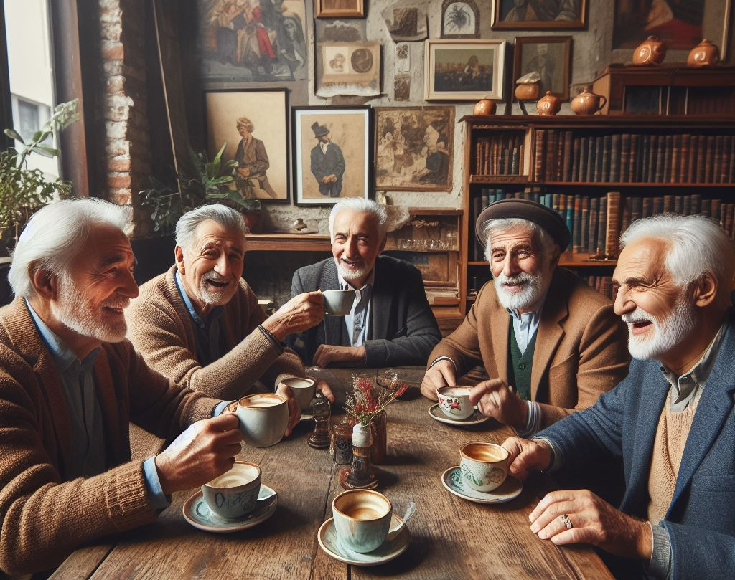
AI generated image
Prompt: “Draw a picture of a group of older men drinking coffee.”
Notes:
A.I. buddies

Slide 16

AI generated image
Prompt: “Draw a picture of a group of older men drinking coffee in the style of Van Gogh.”
Notes:
A.I. buddies

